Slide 1
Data Warehouse Design and Data Analytics

Slide 2
Data Analytics
Overview
Data Warehousing
Online Analytical Processing

Slide 3
Overview
Data analytics: the processing of data to infer patterns, correlations, or models for prediction
Primarily used to make business decisions
Per individual customer
E.g., what product to suggest for purchase (Mining)
Across all customers
E.g., what products to manufacture/stock, in what quantity (DSS)
Critical for businesses today

Slide 4
Overview (Cont.)
Common steps in data analytics
Gather data from multiple sources into one location
Data warehouses also integrated data into common schema
Data often needs to be extracted from source formats, transformed to common schema, and loaded into the data warehouse
Can be done as ETL (extract-transform-load), or ELT (extract-load-transform)

Slide 5
Overview (Cont.)
Generate aggregates and reports summarizing data
Dashboards showing graphical charts/reports
Online analytical processing (OLAP) systems allow interactive querying
Statistical analysis using tools such as R/SAS/SPSS
Including extensions for parallel processing of big data
Build predictive models and use the models for decision making

Slide 6
Overview (Cont.)
Predictive models are widely used today
E.g., use customer profile features (e.g. income, age, gender, education, employment) and past history of a customer to predict likelihood of default on loan
and use prediction to make loan decision
E.g., use past history of sales (by season) to predict future sales
And use it to decide what/how much to produce/stock
And to target customers

Slide 7
Overview (Cont.)
Other examples of business decisions:
What items to stock?
What insurance premium to change?
To whom to send advertisements?

Slide 8
Overview (Cont.)
Machine learning techniques are key to finding patterns in data and making predictions
Data mining extends techniques developed by machine-learning communities to run them on very large datasets
The term business intelligence (BI) is synonym for data analytics
The term decision support focuses on reporting and aggregation

Slide 9
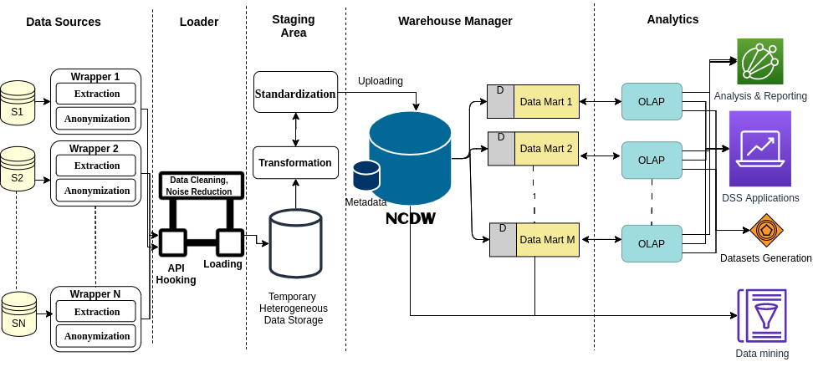
Data Warehouse Concepts Privacy-Preserved National Clinical Data Warehouse Architecture (NCDW)

Slide 10
Data Warehouse Concepts
A data warehouse is a repository (or archive) of information gathered from multiple sources, stored under a unified schema, at a single site.
Once gathered, the data are stored for a long time, permitting access to historical data.
Thus, data warehouses provide the user a single consolidated interface to data, making decision-support queries easier to write.

Slide 11
Data Warehouse Concepts
What schema to use. Data sources that have been constructed independently are likely to have different schemas. In fact, they may even use different data models. Part of the task of a warehouse is to perform schema integration and to convert data to the integrated schema before they are stored.
Data cleansing. The task of correcting and preprocessing data is called data cleansing. Data sources often deliver data with numerous minor inconsistencies, which can be corrected.
Data transformation: Transformation of host format to warehouse format

Slide 12
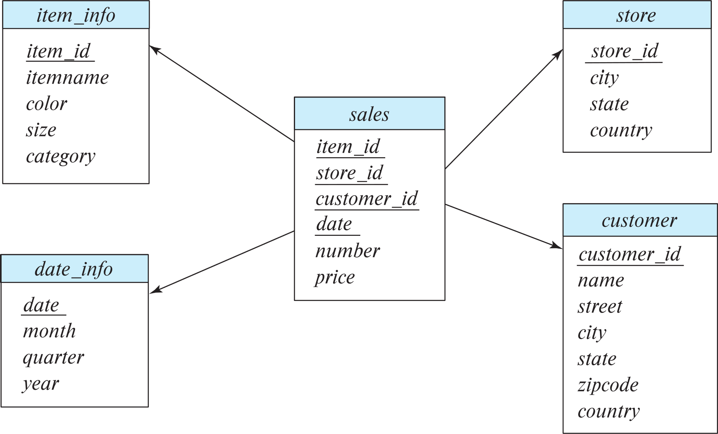
Data Warehouse Concepts
Multidimensional Data and Warehouse Schemas
Data warehouses typically have schemas that are designed for data analysis, using tools such as OLAP tools.
The relations in a data warehouse schema can usually be classified as fact tables and dimension tables.
Fact tables record information about individual events, such as sales, and are usually very large.
A table recording sales information for a retail store, with one tuple for each item that is sold, is a typical example of a fact table.

Slide 13
Data Warehouse Concepts
Multidimensional Data and Warehouse Schemas
The attributes in fact table can be classified as either dimension attributes or measure attributes,
The measure attributes store quantitative information, which can be aggregated upon; the measure attributes of a sales table would include the number of items sold and the price of the items.
In contrast, dimension attributes are dimensions upon which measure attributes, and summaries of measure attributes, are grouped and viewed.

Slide 14
Data Warehouse Concepts
Multidimensional Data and Warehouse Schemas
The dimension attributes of a sales table would include an item identifier, the date when the item is sold, which location (store) the item was sold from, the customer who bought the item, and so on.
Data that can be modeled using dimension attributes and measure attributes are called multidimensional data.
To minimize storage requirements, dimension attributes are usually short identifiers that are foreign keys into other tables called dimension tables.

Slide 15
Designing Star Schema
A fact table sales would have dimension attributes item id, store id, customer id, and date, and measure attributes number and price. The attribute store id is a foreign key into a dimension table store, which has other attributes such as store location (city, state, country). The item id attribute of the sales table would be a foreign key into a dimension table item info, which would contain information such as the name of the item, the category to which the item belongs, and other item details such as color and size. The customer id attribute would be a foreign key into a customer table containing attributes such as name and address of the customer. We can also view the date attribute as a foreign key into a date info table giving the month, quarter, and year of each date.

Slide 16
Designing Star Schema
Design star schema for for National Board of Revenue.
Measure attributes: Tax amount, income,
Dimensions:
Tax payer
Tax Collector
Time
Source

Slide 17
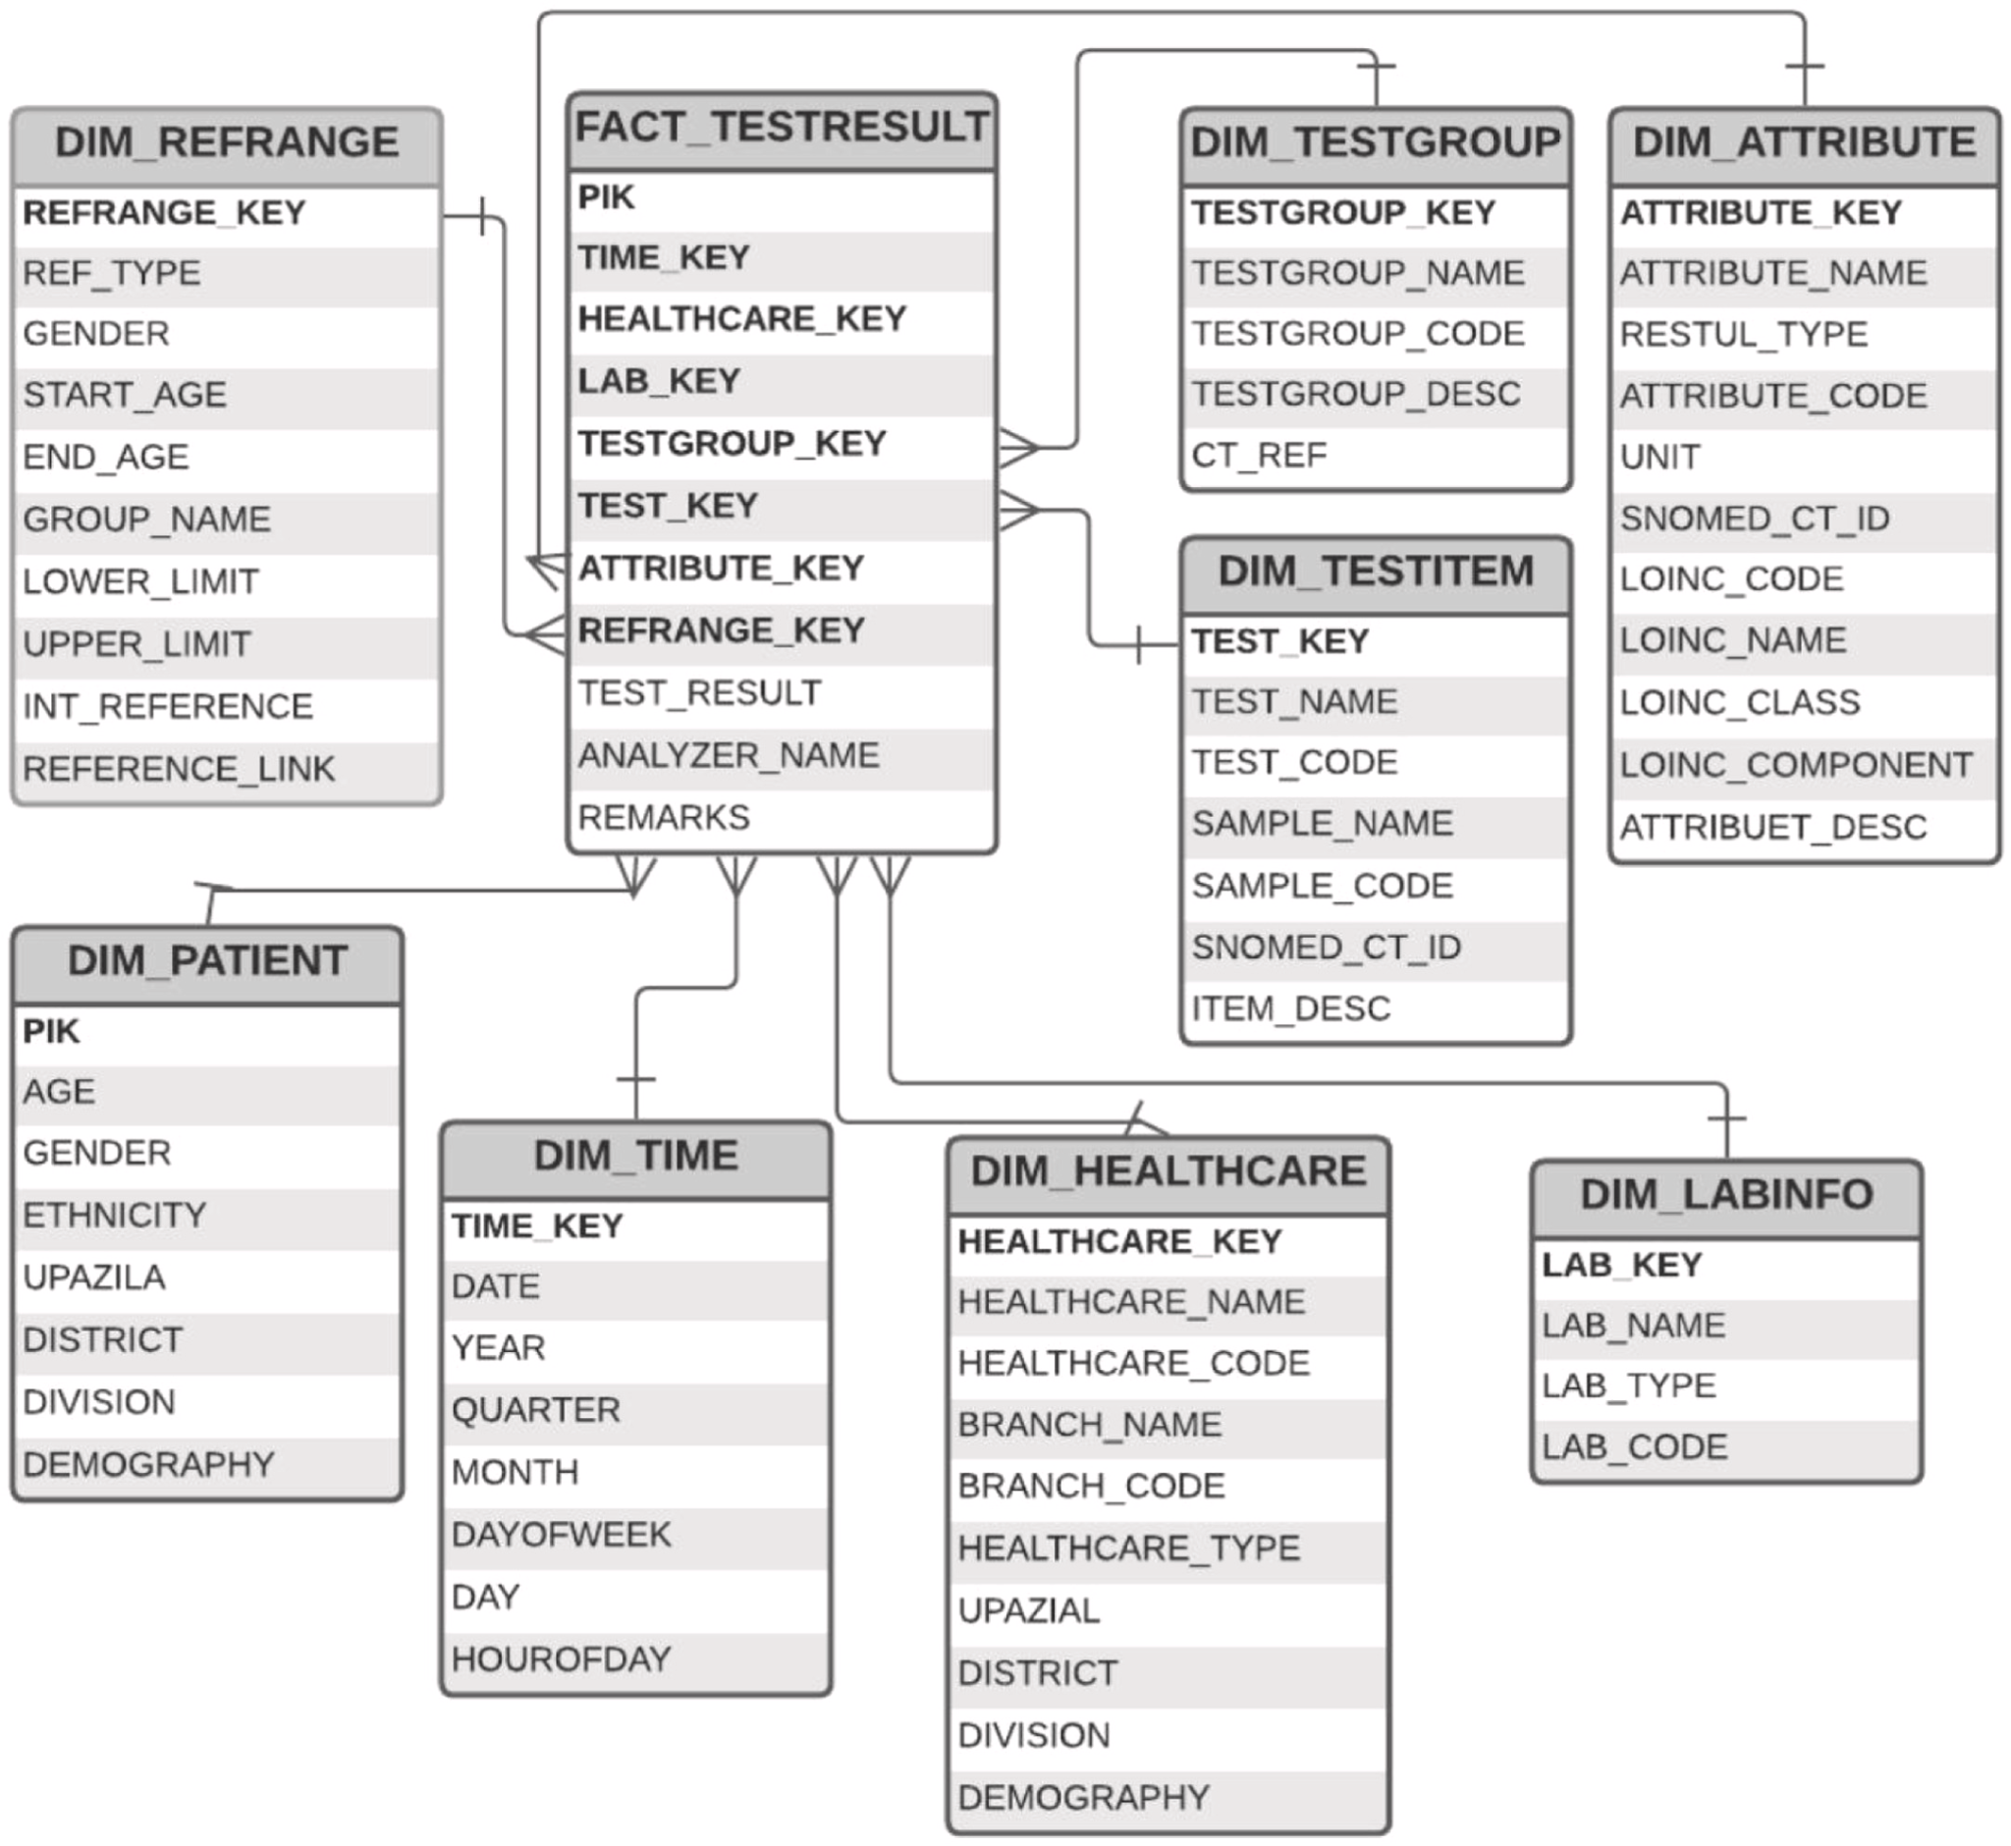
Multidimensional Data Model for NCDW

Slide 18
Data Analysis and OLAP
Online Analytical Processing (OLAP)
Interactive analysis of data, allowing data to be summarized and viewed in different ways in an online fashion (with negligible delay)
We use the following relation to illustrate OLAP concepts
sales (item_name, color, clothes_size, quantity)
This is a simplified version of the sales fact table joined with the dimension tables, and many attributes removed (and some renamed)

Slide 19
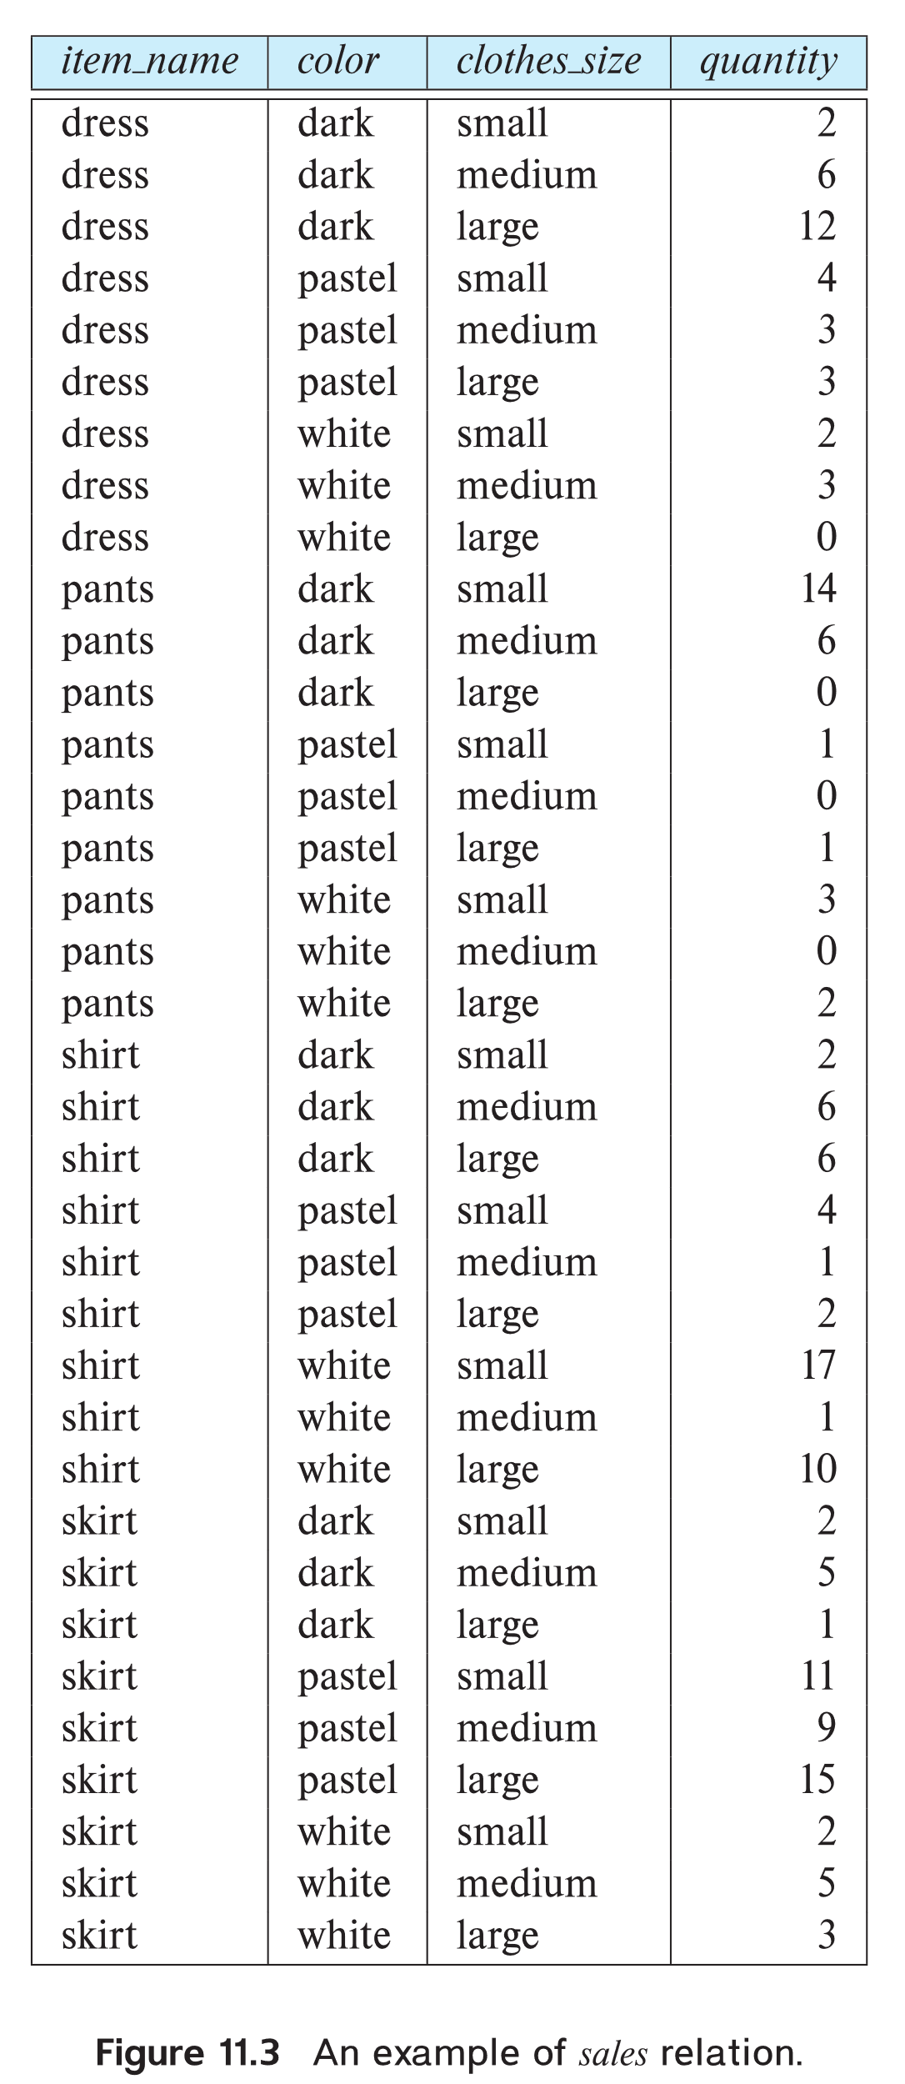
Example sales relation
How can we get the table
Sales-item (item_name, color, clothes_size, quantity)
From star schema?
Answer:
Select item_name, color, clothes_size, number as quantity
From item_info a, sales b
Where a.item_id = b.item_id
...
...
...
...
...
...
...
...

Slide 20
Cross Tabulation of sales by item_name and color
How can you find the cross-tab of sales?
Write SQL to find the cross-tab.
SQL for cloth_size:
Select sum(quantity) from sales
SQL for total of item_name:
Select item_name, sum(quantity)
From sales
Group by item_name
The table above is an example of a cross-tabulation (cross-tab), also referred to as a pivot-table.
Values for one of the dimension attributes form the row headers
Values for another dimension attribute form the column headers
Other dimension attributes are listed on top
Values in individual cells are (aggregates of) the values
of the dimension attributes that specify the cell.
SQL for total of color:
Select color, sum(quantity)
From sales
Group by color
SQL for other cells:
Select item_name, color, sum(quantity)
From sales
Group by item_name, color

Slide 21
Cross Tabulation of sales by item_name and color
How can you find the cross-tab of sales?
Write SQL to find the cross-tab.
SQL for cloth_size:
Select sum(quantity) from sales
SQL for total of item_name:
Select item_name, sum(quantity)
From sales
Group by item_name
Question:
Write cross tabulation structure of sales by cloth_size and item_name.
Write SQL to find the cross-tab
SQL for total of color:
Select color, sum(quantity)
From sales
Group by item_name
SQL for other cells:
Select item_name, color, sum(quantity)
From sales
Group by item_name, color

Slide 22
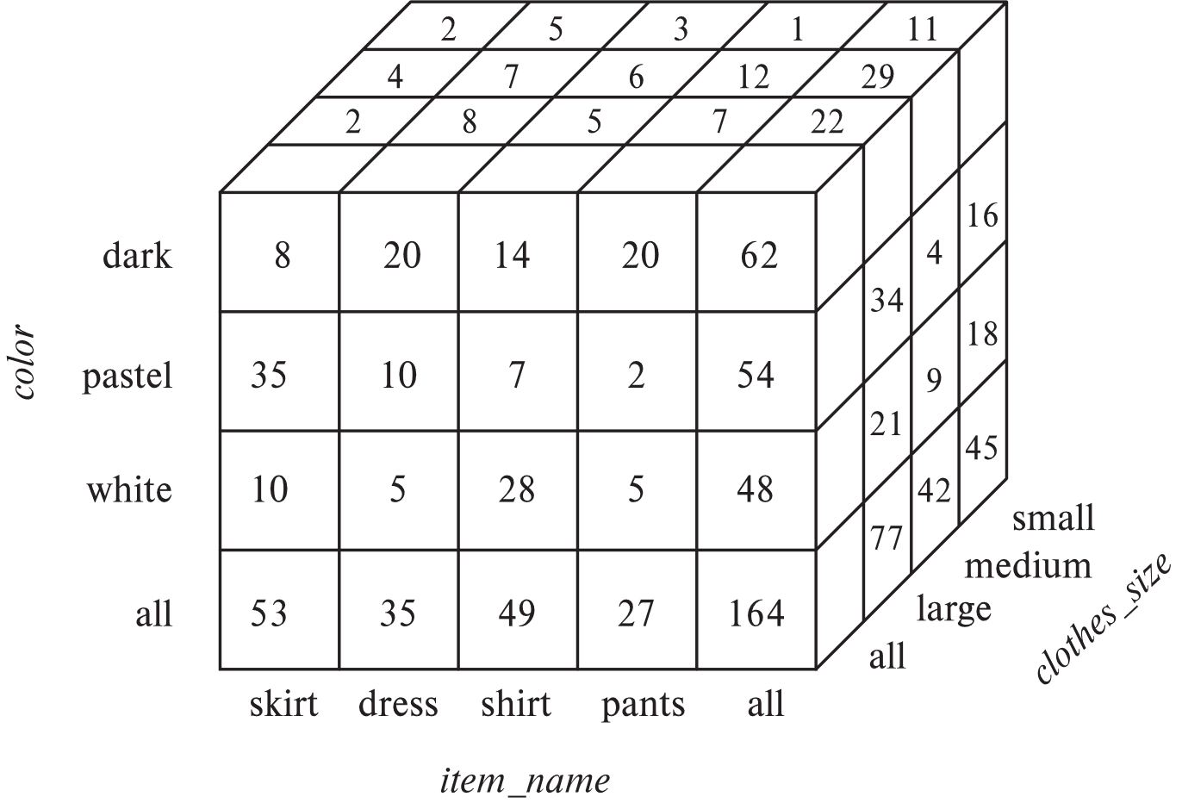
Data Cube
A data cube is a multidimensional generalization of a cross-tab
Can have n dimensions; we show 3 below
Cross-tabs can be used as views on a data cube

Slide 23
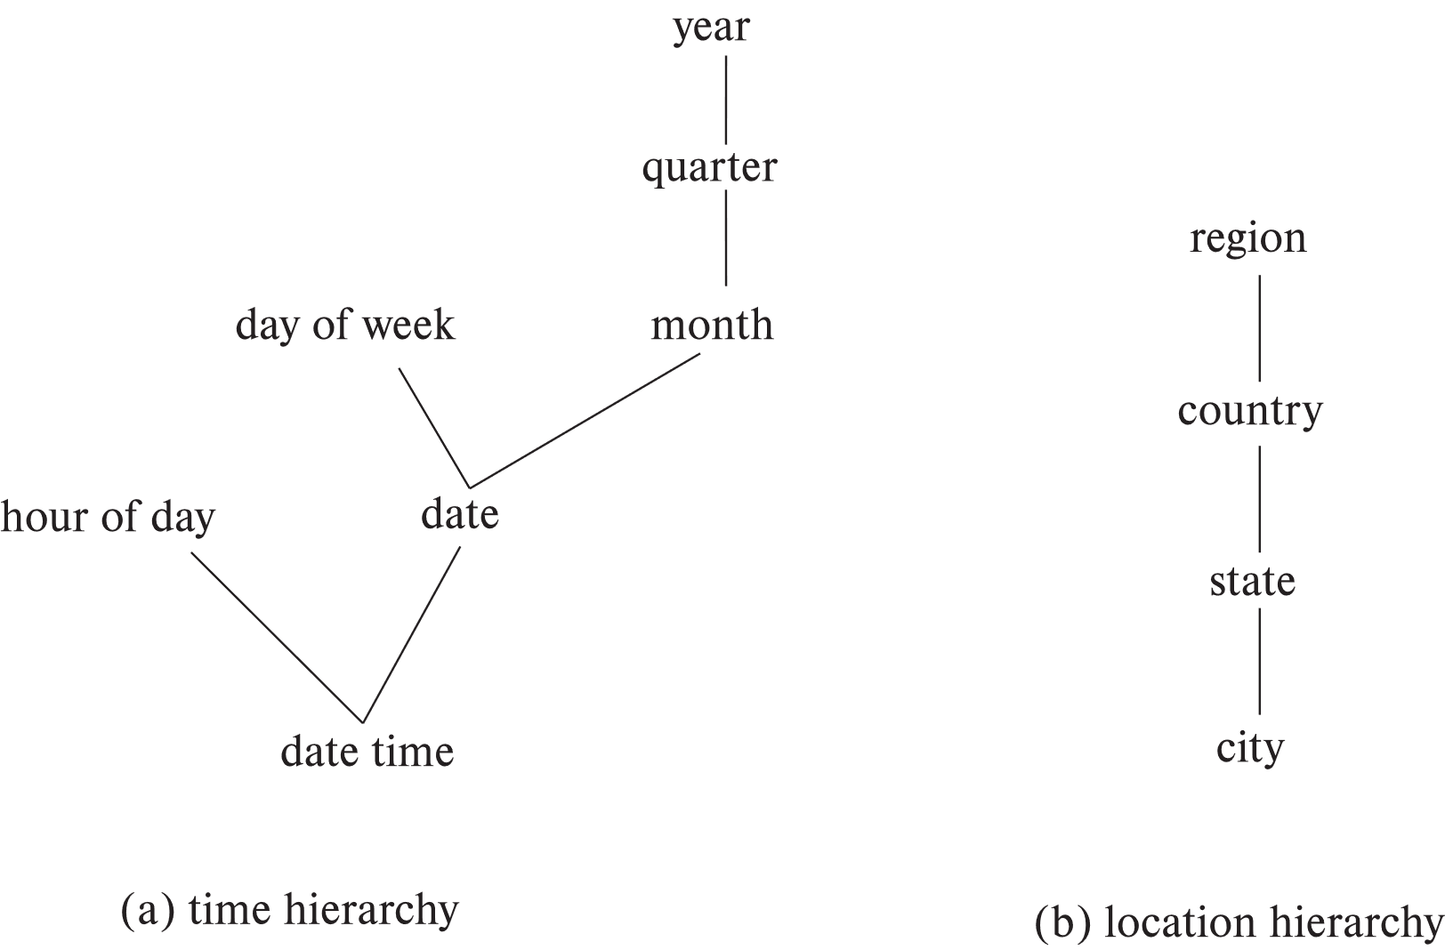
Hierarchies on Dimensions
Hierarchy on dimension attributes: lets dimensions be viewed at different levels of detail
E.g., the dimension datetime can be used to aggregate by hour of day, date, day of week, month, quarter or year

Slide 24
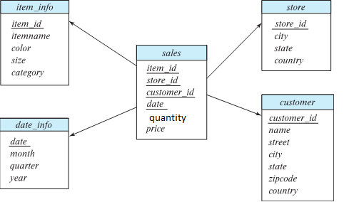
Hierarchies on Dimensions
How can you prepare DSS reports based on hierarchy?
Report on date (Year, , quarter, month, date wise report)
R1 = select year, quarter, month, date, sum(quantity) as tot_d from sales s, date_info d Where s.date = d.date Group by year, quarter, month, date
Report on date (Year, , quarter, month wise report)
R2 = select year, quarter, month sum(tot_d) as tot_m from R1 Where s.date = d.date Group by year, quarter, month, date

Slide 25
Hierarchies on Dimensions
How can you prepare DSS reports based on hierarchy?
Report on date (Year, , quarter, month, date wise report)
R1 = select year, quarter, month, date, sum(quantity) as tot_d from sales s, date_info d Where s.date = d.date Group by year, quarter, month, date
Report on month (Year, , quarter, month wise report)
R2 = select year, quarter, month sum(tot_d) as tot_m from R1 Where s.date = d.date Group by year, quarter, month, date
Report on quarter (Year, quarter wise report)
R3 = select year, quarter sum(tot_m) as tot_q from R2
Group by year, quarter
Report on year (Year wise report)
R4 = select year sum(tot_q) as tot_y from R3
Group by year
** R1, R2 R3, and R4 may be stored in the database as materialized view

Slide 26
Hierarchies on Dimensions
How can you prepare DSS reports based on hierarchy?
Report on date:
R1 = select year, quarter, month, date, sum(quantity) as tot_d from sales
Group by year, quarter, month, date
R2 = select year, quarter, month sum(tot_d) as tot_m from R1
Group by year, quarter, month
R3 = select year, quarter sum(tot_m) as tot_q from R2
Group by year, quarter
R4 = select year sum(tot_q) as tot_y from R3
Group by year
** R1, R2 R3, and R4 may be stored in the database as materialized view
Question: Find all DSS reports on location hierarchy

Slide 27
Data Warehouse Queries
Rollup
The ROLLUP is an extension of the GROUP BY clause.
The ROLLUP option allows you to include extra rows that represent the subtotals, which are commonly referred to as super-aggregate rows, along with the grand total row.
By using the ROLLUP option, you can use a single query to generate multiple grouping sets.

Slide 28
Data Warehouse Queries
Rollup
The ROLLUP Example:
SELECT c1, c2, aggregate_function(c3)
FROM table
GROUP BY ROLLUP (c1, c2);
In the syntax above, ROLLUP(c1,c2) generates three following grouping sets:
(c1,c2)
(c1)
()

Slide 29
Data Warehouse Queries
CUBE
Similar to the ROLLUP, CUBE is an extension of the GROUP BY clause.
CUBE allows you to generate subtotals like the ROLLUP extension.
In addition, the CUBE extension will generate subtotals for all combinations of grouping columns specified in the GROUP BY clause.

Slide 30
Data Warehouse Queries
CUBE
The CUBE Example:
SELECT c1, c2, AGGREGATE_FUNCTION(c3)
FROM table_name
GROUP BY CUBE(c1 , c2);
In this syntax, we have two columns specified in the CUBE.
The statement creates two subtotal combinations.
Generally, if you have n number of columns listed in the CUBE, the statement will create 2^{n} subtotal combinations.

